Slide 1


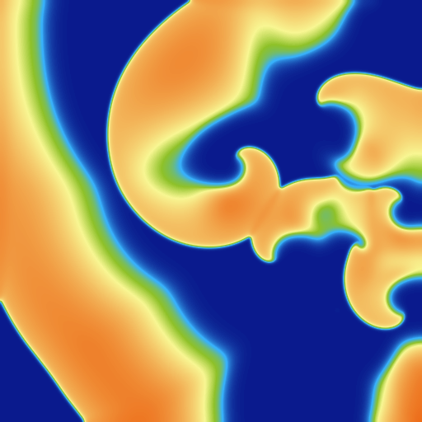
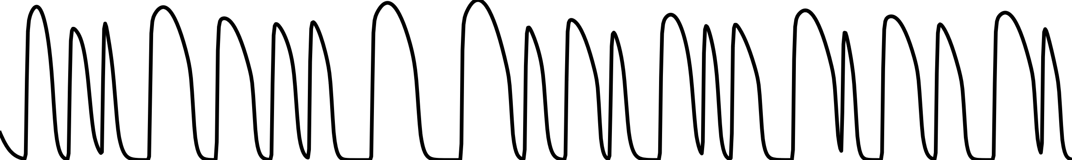
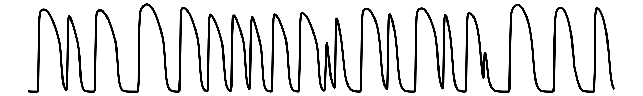
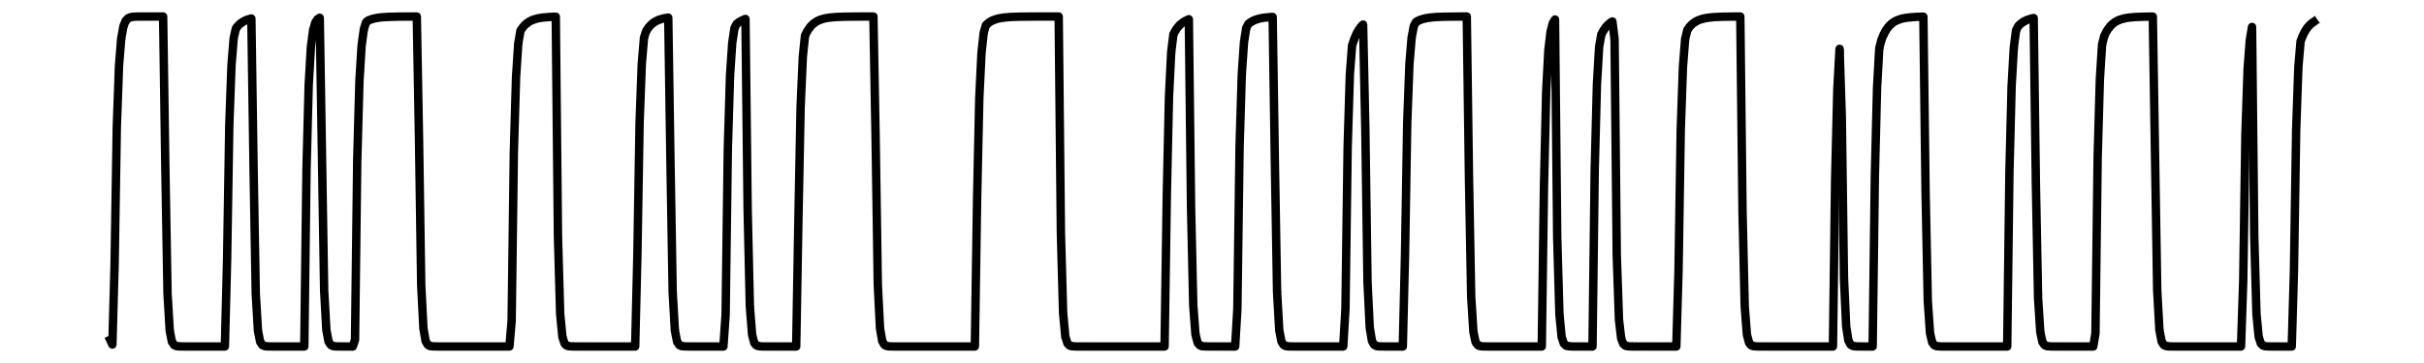
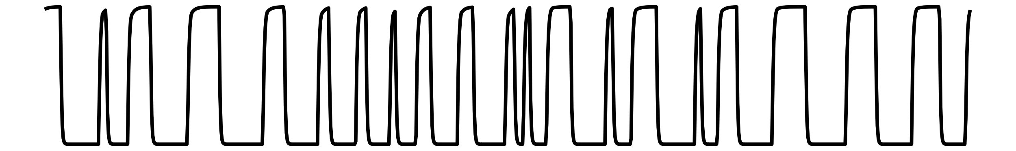
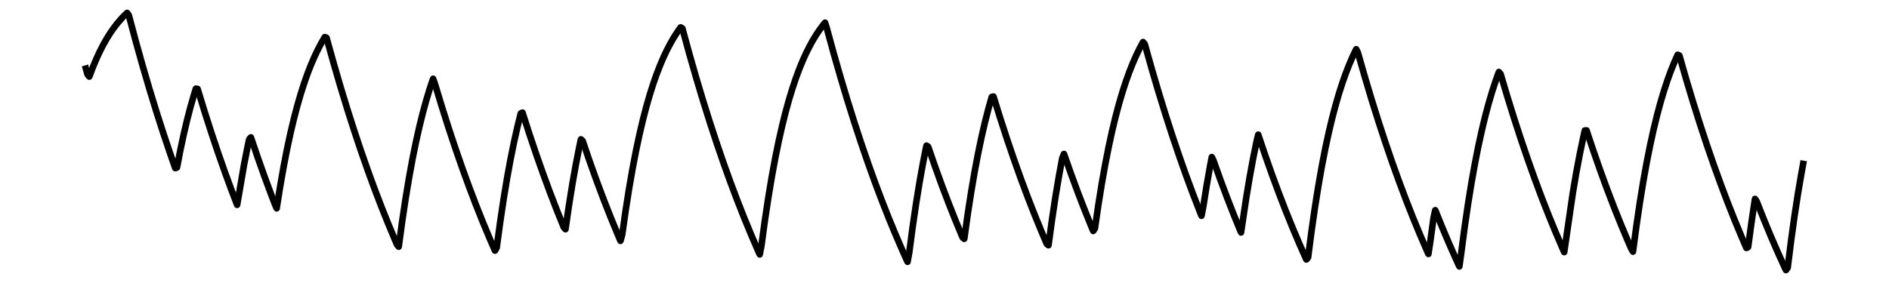
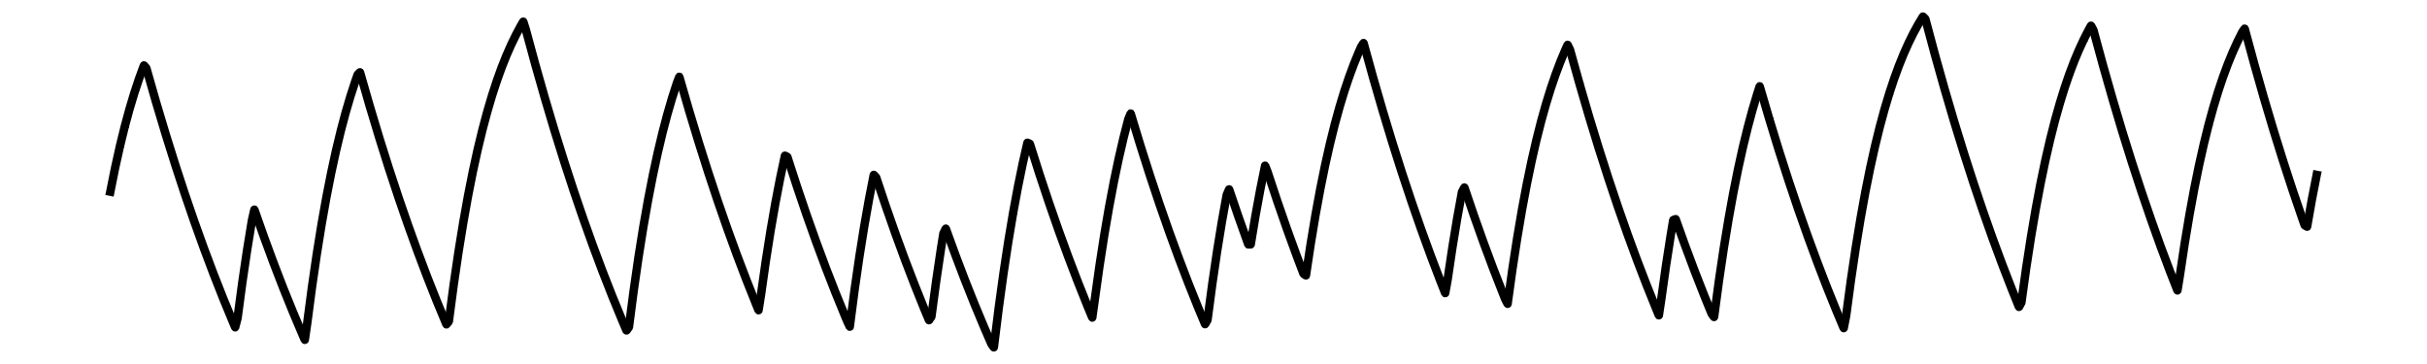
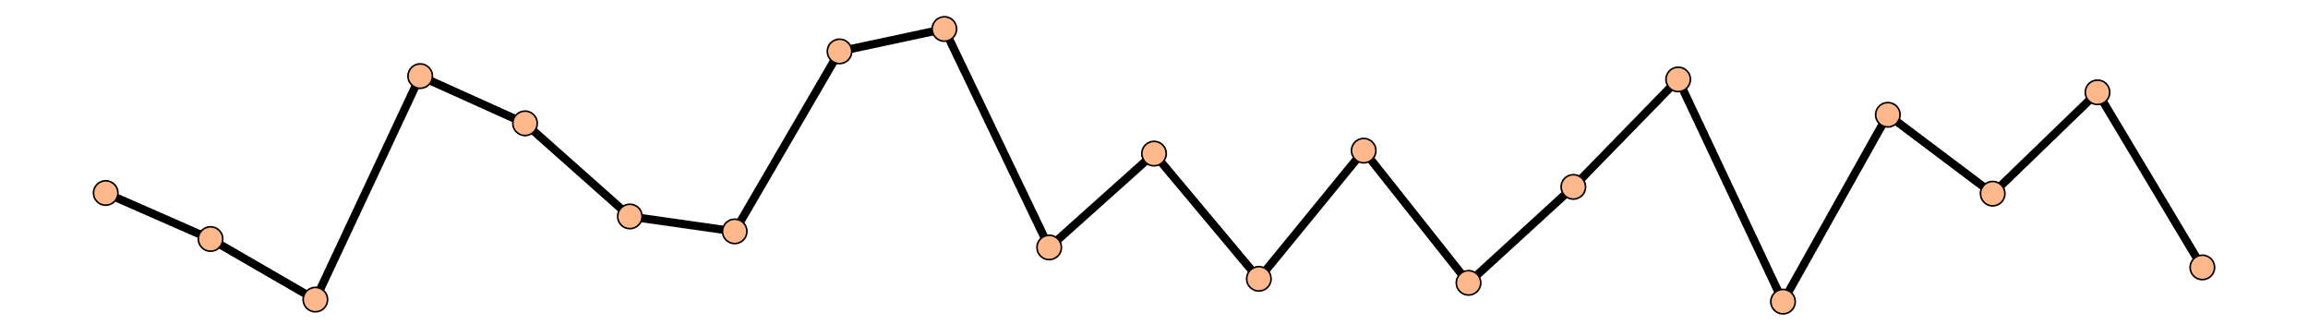
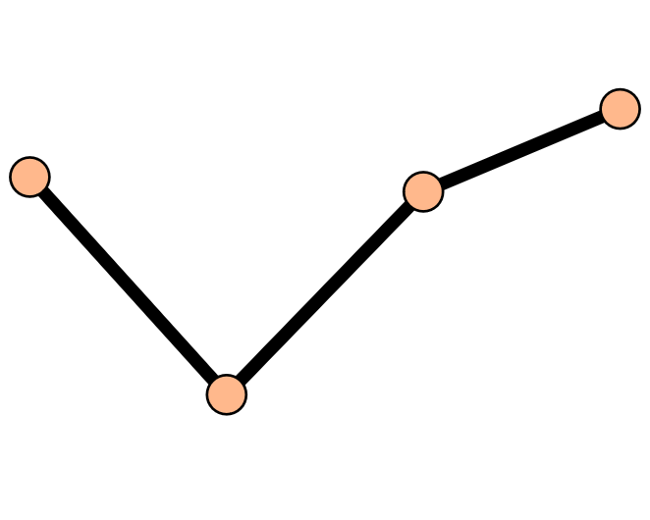
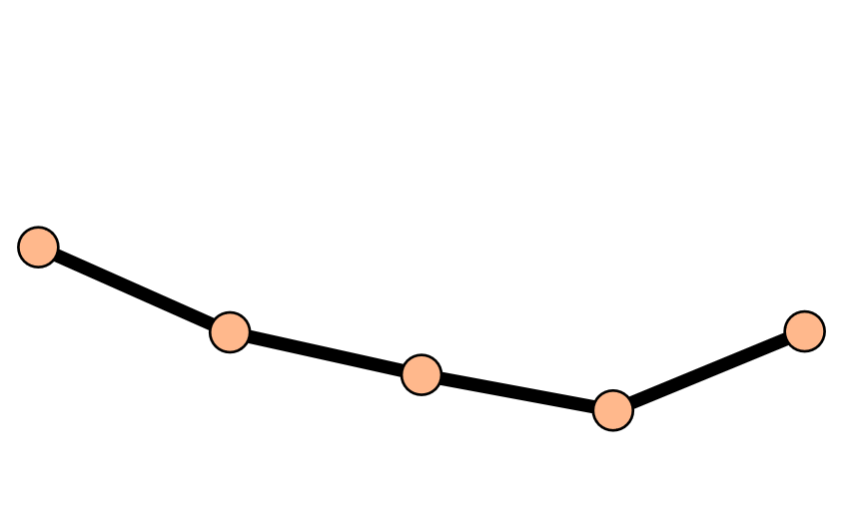
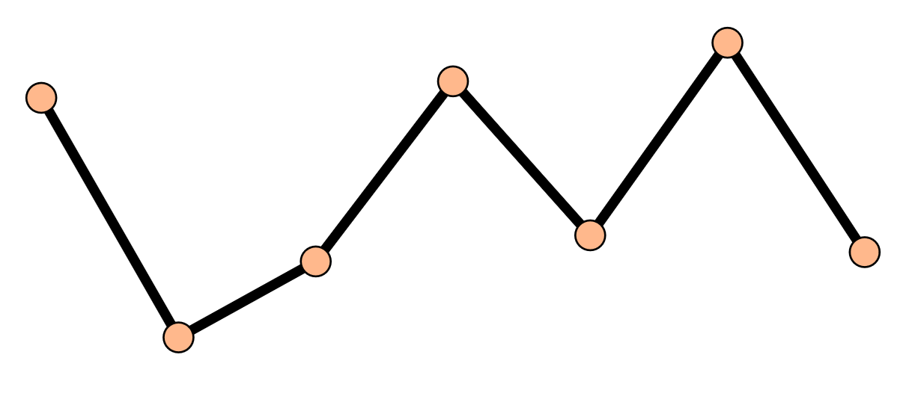
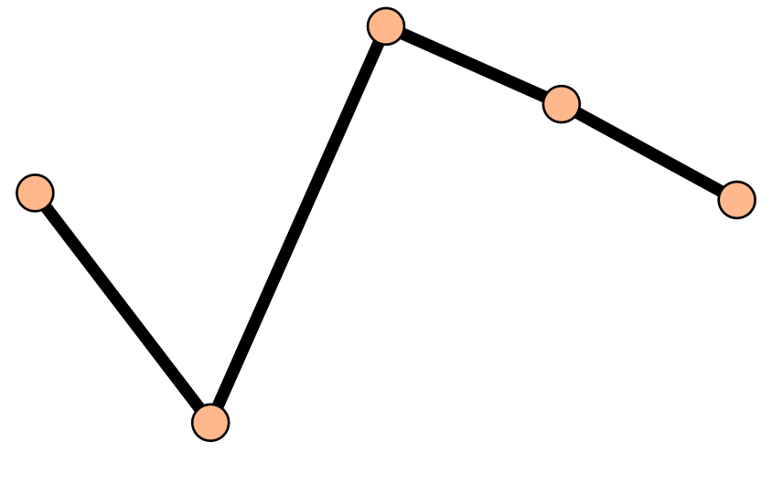
















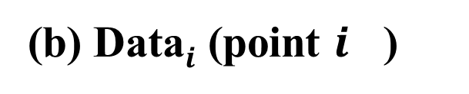













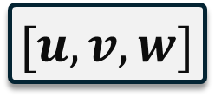


(a) Simulation
Phase Space Reconstructor (PSR)
Temporal Calculator (TC)
$$i$$
APD
● ● ●
$$R_{0}^{1}$$
TLE
$${LE}_{i}^{1}$$
AVG
$$LE^{1}$$
AVG
$${ λ}^{T}$$
$$m=3 τ=1$$
● ● ●
● ● ●
● ● ●
● ● ●
$$R_{i}^{1}$$
TLE
$${ LE}_{i+1}^{1}$$
$$LE^{5}$$
$${\left\{\text{APD}\right\}}_{m,τ}$$
● ● ●
● ● ●
● ● ●
● ● ●
$$R_{N}^{1}$$
TLE
$${LE}_{N}^{1}$$
(b) Data$i$ (point $i$ )
Spatial Calculator (SC)
Voltage(u)
● ● ●
● ● ●
● ● ●
● ● ●
● ● ●
$$R_{0}^{1}$$
● ● ●
SLE
$$LE^{1}$$
AVG
v
● ● ●
● ● ●
● ● ●
● ● ●
● ● ●
$$R_{i}^{1}$$
$${ λ}^{S}$$
● ● ●
● ● ●
w
● ● ●
● ● ●
● ● ●
● ● ●
● ● ●
$$R_{N}^{1}$$
$$LE^{5}$$
APD
● ● ●
● ● ●
● ● ●
● ● ●
● ● ●
Temporal LE (TLE)
Spatial LE (SLE)
Time step
0
Transient
52e4
$$R_{i}^{1}$$
$$R_{i}^{2}$$
$$R_{i}^{3}$$
$$R_{i}^{4}$$
$$R_{i}^{5}$$
183e4
$${ R}_{0}$$
● ● ●
(c) LE Calculation
$$R_{i}$$
$${ R}_{i}$$
$$[u,v,w]$$
TC
$${ λ}^{T}(uvw)$$
● ● ●
● ● ●
Data
$${ R}_{N}$$
APD
PSR
$${\left\{\text{APD}\right\}}_{m,τ}$$
SC
$${ λ}^{S}(\text{APD})$$
Observe Divergence Of Similar Pairs in Time Series
Observe Divergence Of Similar Pairs in Space
TC
$${ λ}^{T}(\text{APD})$$

